Slide 1
Data Binning
By Or Dinar, Liad Ackerman and Maayan Ben Zion
Guided by Dr. Adi Akavia

Slide 2
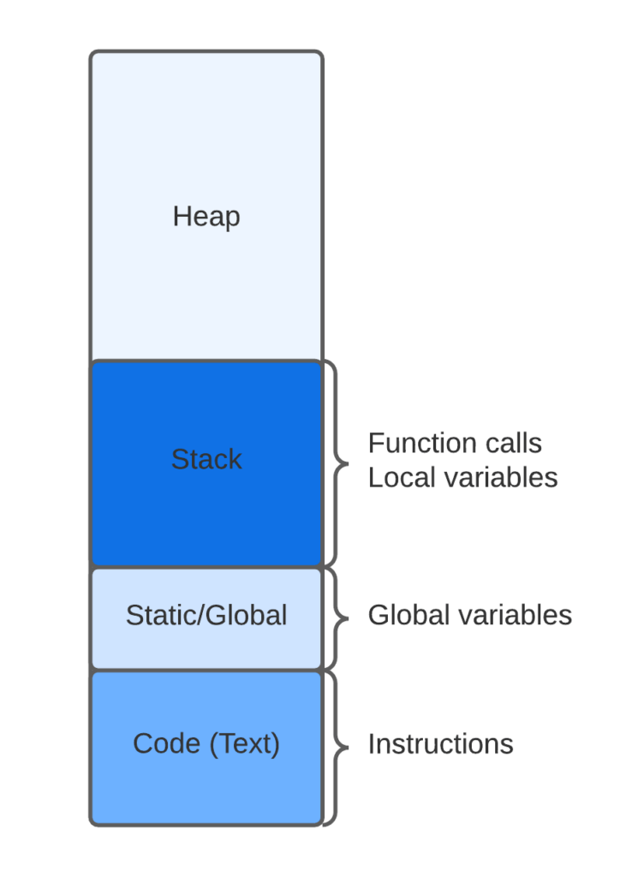

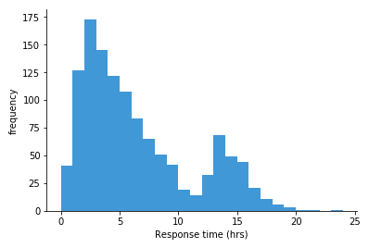
Topics
Balanced Allocation
Cuckoo Hashing
Data Binning

Slide 3
Data Generalization
Data generalisation involves sorting sensitive columns into bins or groups for analysis, removing specifics and creating a more generalised view. This technique, in combination with other pseudonymisation methods, is particularly effective for large datasets.
Balanced Allocation
Cuckoo Hashing
Data Binning

Slide 4
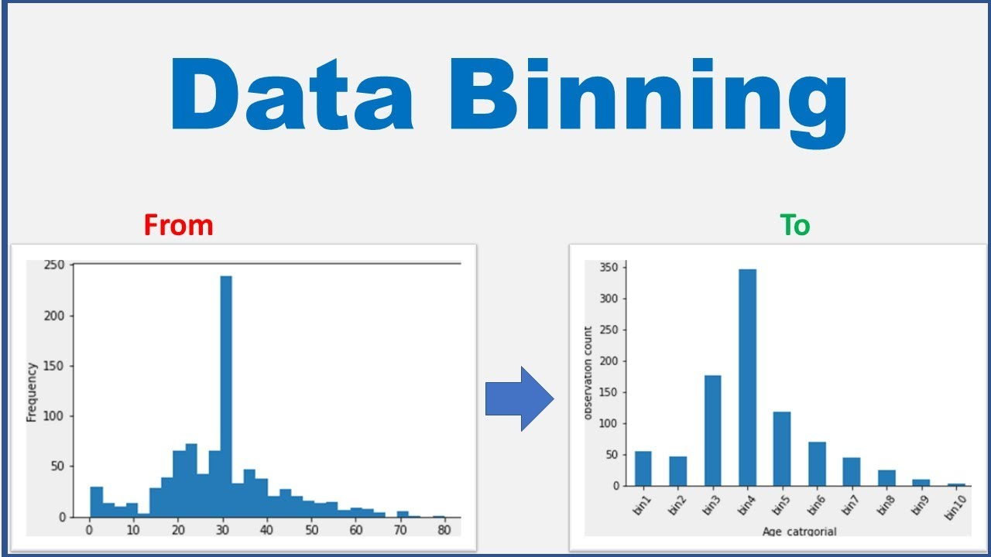
Definition of Data Binning
‘Discretization or “binning” is a common form of data preprocessing, aimed at grouping continuous or numerical values into a smaller number of bins (buckets).’
Balanced Allocation
Cuckoo Hashing
Data Binning

Slide 5

Examples of Data Binning
Balanced Allocation
Cuckoo Hashing
Data Binning
Recycling:
Glass
Plastic
Paper
Organic
Metals
Electronic Waste

Slide 6
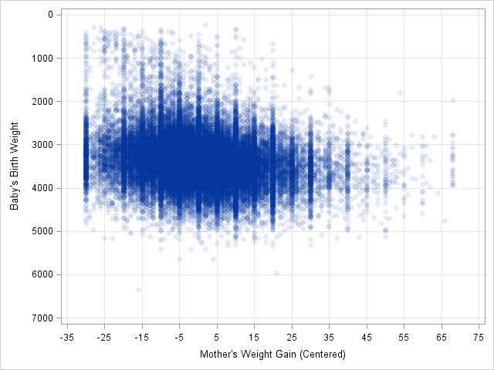
Examples of Data Binning
Balanced Allocation
Cuckoo Hashing
Data Binning
Binning an extensive amount of data into discrete values.

Slide 7
Steps
Balanced Allocation
Cuckoo Hashing
Data Binning
1
Identify the range of all values
2
Choose a suitable Binning method
3
Choose the amount of bins
4
Sort the data in the defined range
5
Analyze the data

Slide 8
Types of Binning
Balanced Allocation
Cuckoo Hashing
Data Binning
Supervised Binning
Unsupervised Binning
design

Slide 9
Binning methods
Balanced Allocation
Cuckoo Hashing
Data Binning
Equal-Width Binning
Equal-Frequency Binning
Entropy-Based Binning
Custom Binning
Quantile Binning
Optimal Binning
design

Slide 10
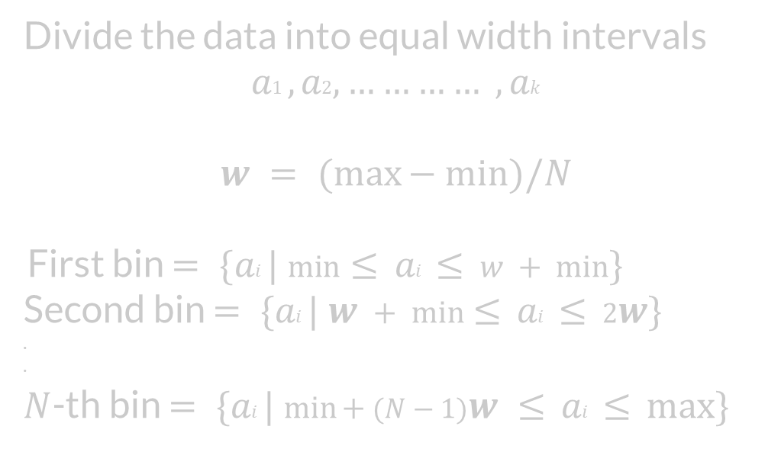
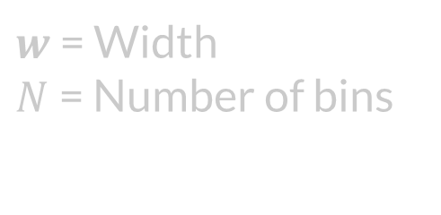
Equal-Width Binning
Balanced Allocation
Cuckoo Hashing
Data Binning
design

Slide 11
Equal-Width Binning
Balanced Allocation
Cuckoo Hashing
Data Binning
Cons | Pros
Loss of Information Impact of width selection Sensitivity to Data Distribution | Simplicity Interpretability Outlier Insensitivity

Slide 12
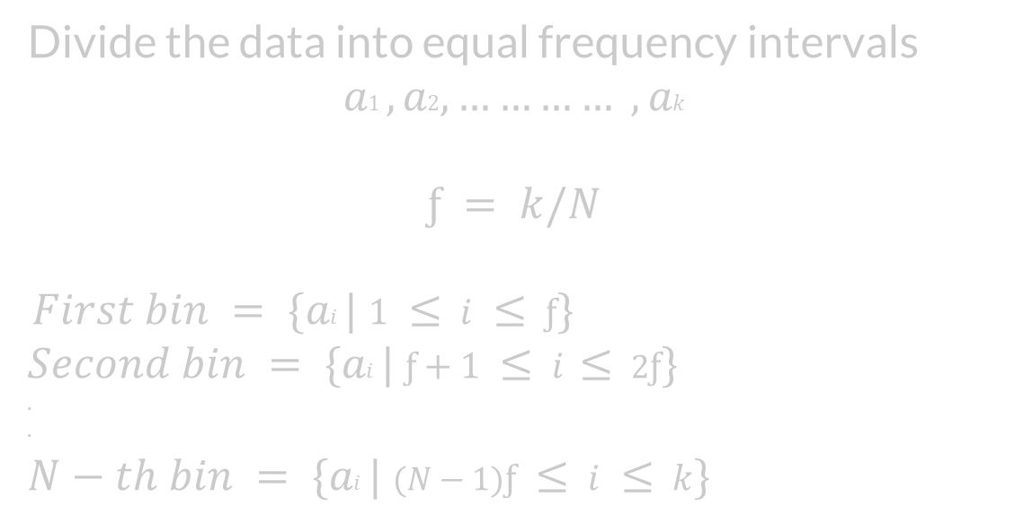
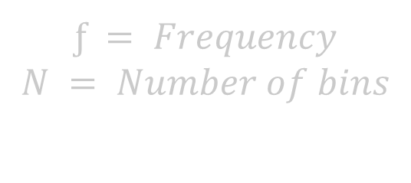
Equal-Frequency Binning
Balanced Allocation
Cuckoo Hashing
Data Binning
design

Slide 13
Equal-Width Binning
Balanced Allocation
Cuckoo Hashing
Data Binning
Cons | Pros
Loss of Information Impact of Bin selection Sensitivity to Data Distribution | Balanced Representation Reduce Impact of Outliers Interpretability

Slide 14
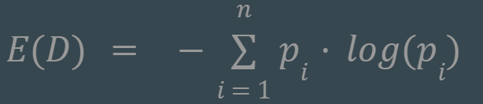
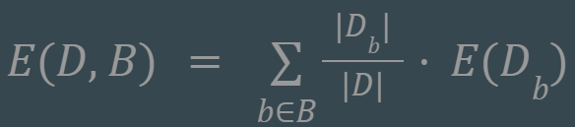

Entropy-Based Binning
Balanced Allocation
Cuckoo Hashing
Data Binning
find bin boundaries that maximize the information gain or minimize the uncertainty within each bin.
Calculate Entropy:
Calculate Entropy given a bin:
3. Calculate Information gain:

Slide 15
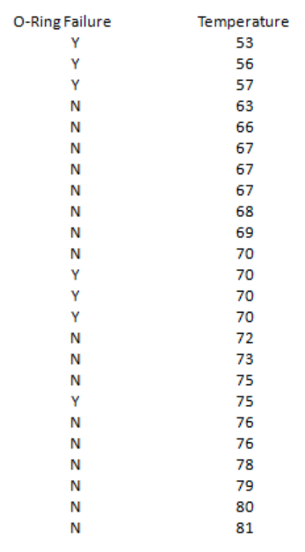
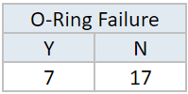
Entropy-Based Binning
Balanced Allocation
Cuckoo Hashing
Data Binning
Calculate Entropy:
E(Failure) = E(7,17) = E(0.29,0.71)
= -[0.29∙log(0.29) + 0.71∙log(0.71)]
= 0.871

Slide 16
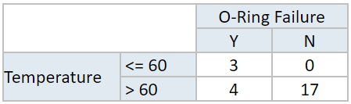
Entropy-Based Binning
Balanced Allocation
Cuckoo Hashing
Data Binning
2. Calculate Entropy given a bin:
E(Failure,Temp) = P(≤60)∙E(3,0) + P(>60)∙E(4,17)
= (3/24)∙0 + (21/24)∙0.7
= 0.615

Slide 17
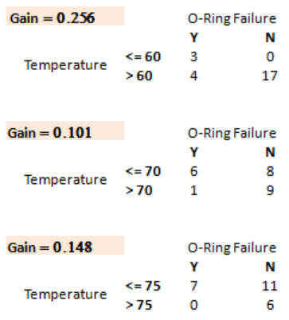
Entropy-Based Binning
Balanced Allocation
Cuckoo Hashing
Data Binning
3. Calculate Information gain:

Slide 18
Hashing
Balanced Allocation
Data Binning
Cuckoo Hashing
Keys
Hash Function
Hash Table
0
John
1
John
2
Moshe
Moshe
3
Abraham
Abraham
4
Boris
5
Boris
6
7

Slide 19
Hashing
Balanced Allocation
Data Binning
Cuckoo Hashing
Keys
Hash Function
Hash Table
Abraham
0
John
1
2
Moshe
John
3
Abraham
4
Boris
5
6
Moshe
7
Boris

Slide 20
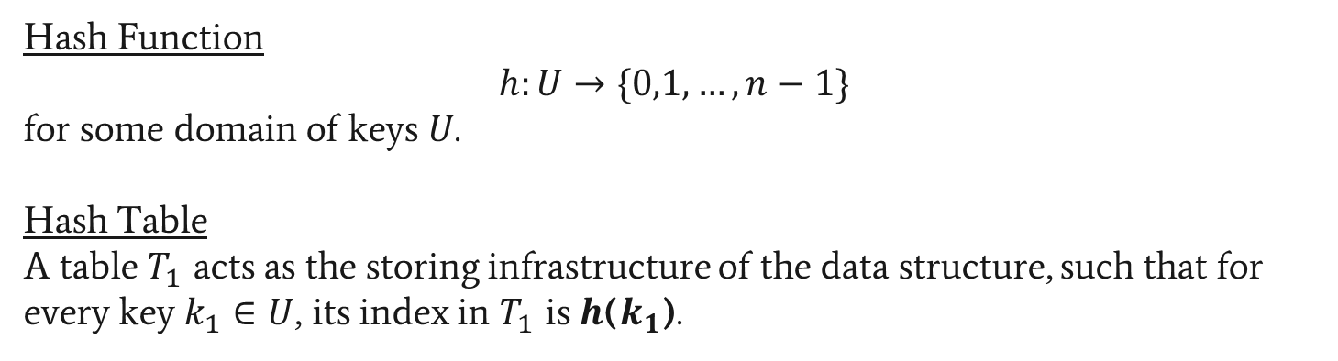
Hashing
Balanced Allocation
Data Binning
Cuckoo Hashing
Hash Function
$$h:U→\{0,1,…,n−1\}$$
for some domain of keys $U$.
Hash Table
A table $T_{1}$ acts as the storing infrastructure of the data structure, such that for every key $k_{1}∈U$, its index in $T_{1}$ is $h$($k_{1}$).

Slide 21



Hashing - Operations
Balanced Allocation
Data Binning
Cuckoo Hashing
Insert
Lookup
Delete
All operations’ complexity is O(n) when using Linked Lists
All operations’ complexity is O(logn) when using BST
Amortized complexity is O(1)

Slide 22


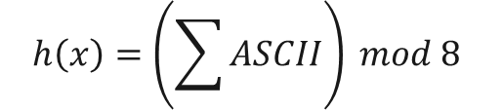


Hashing - Example
Balanced Allocation
Data Binning
Cuckoo Hashing
Keys
Hash Function
Hash Table
0
$$h\left(John\right)=7$$
John
1
2
$$h\left(Moshe\right)=4$$
Moshe
3
$$h\left(Abraham\right)=4$$
Abraham
4
$$h\left(Boris\right)=7$$
Boris
5
6
7
$$h\left(x\right)=\left(\sum{ASCII}\right) mod 8$$

Slide 23
Hashing - Example
Balanced Allocation
Data Binning
Cuckoo Hashing
Keys
Hash Function
Hash Table
Insert(John)
0
$$h\left(John\right)=7$$
John
1
2
$$h\left(Moshe\right)=4$$
Moshe
3
$$h\left(Abraham\right)=4$$
Abraham
4
$$h\left(Boris\right)=7$$
Boris
5
6
John
7
$$h\left(x\right)=\left(\sum{ASCII}\right) mod 8$$

Slide 24
Hashing - Example
Balanced Allocation
Data Binning
Cuckoo Hashing
Keys
Hash Function
Hash Table
Insert(Moshe)
0
$$h\left(John\right)=7$$
John
1
2
$$h\left(Moshe\right)=4$$
Moshe
3
$$h\left(Abraham\right)=4$$
Abraham
4
Moshe
$$h\left(Boris\right)=7$$
Boris
5
6
John
7
$$h\left(x\right)=\left(\sum{ASCII}\right) mod 8$$

Slide 25
Hashing - Example
Balanced Allocation
Data Binning
Cuckoo Hashing
Keys
Hash Function
Hash Table
Insert(Abraham)
0
$$h\left(John\right)=7$$
John
1
2
$$h\left(Moshe\right)=4$$
Moshe
3
$$h\left(Abraham\right)=4$$
Abraham
Abraham
4
Moshe
$$h\left(Boris\right)=7$$
Boris
5
6
John
7
$$h\left(x\right)=\left(\sum{ASCII}\right) mod 8$$

Slide 26
Hashing - Example
Balanced Allocation
Data Binning
Cuckoo Hashing
Keys
Hash Function
Hash Table
Insert(Boris)
0
$$h\left(John\right)=7$$
John
1
2
$$h\left(Moshe\right)=4$$
Moshe
3
$$h\left(Abraham\right)=4$$
Abraham
Abraham
4
Moshe
$$h\left(Boris\right)=7$$
Boris
5
6
7
Boris
John
$$h\left(x\right)=\left(\sum{ASCII}\right) mod 8$$

Slide 27
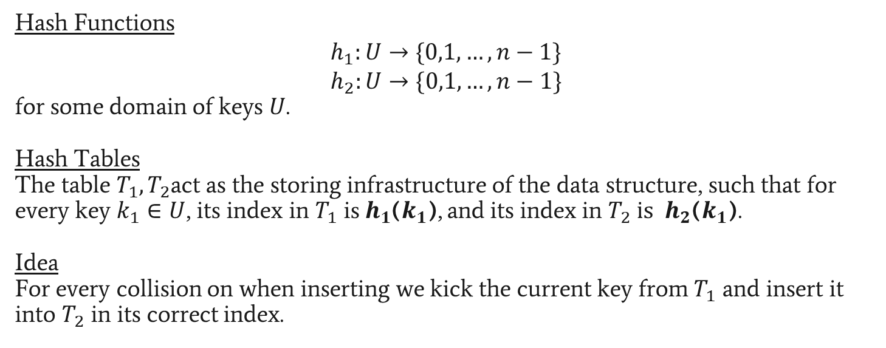
Cuckoo Hashing
Balanced Allocation
Data Binning
Cuckoo Hashing
Hash Functions
$$h_{1}:U→\{0,1,…,n−1\}$$
$$h_{2}:U→\{0,1,…,n−1\}$$
for some domain of keys $U$.
Hash Tables
The table $T_{1},T_{2}$act as the storing infrastructure of the data structure, such that for every key $k_{1}∈U$, its index in $T_{1}$ is$h_{1}$($k_{1}$), and its index in $T_{2} is$ $h_{2}$($k_{1}$).
Idea
For every collision on when inserting we kick the current key from $T_{1}$ and insert it into $T_{2}$ in its correct index.

Slide 28
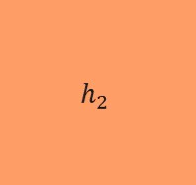







Cuckoo Hashing
Balanced Allocation
Data Binning
Cuckoo Hashing
Keys
Hash Functions
Hash Table 1
Hash Table 2
$$h_{1}$$
0
0
$$k_{1}$$
1
1
$$k_{2}$$
2
2
$$k_{3}$$
3
3
$$k_{4}$$
4
4
$$h_{2}$$
$$k_{5}$$
5
5
$$k_{6}$$
6
6
7
7

Slide 29
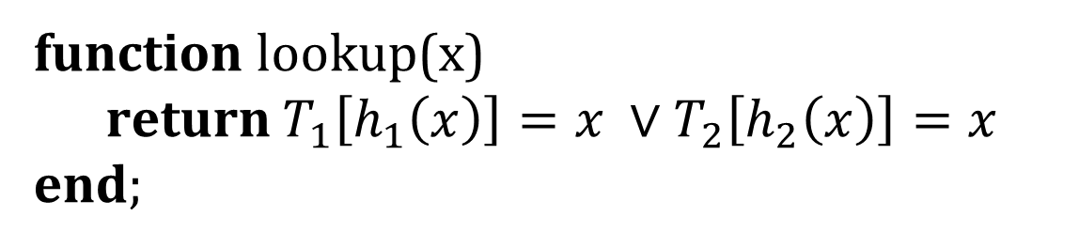
Cuckoo Hashing - Lookup
Balanced Allocation
Data Binning
Cuckoo Hashing
function lookup(x)
return $T_{1}\left[h_{1}\left(x\right)\right]=x ∨T_{2}\left[h_{2}\left(x\right)\right]=x$
end;

Slide 30
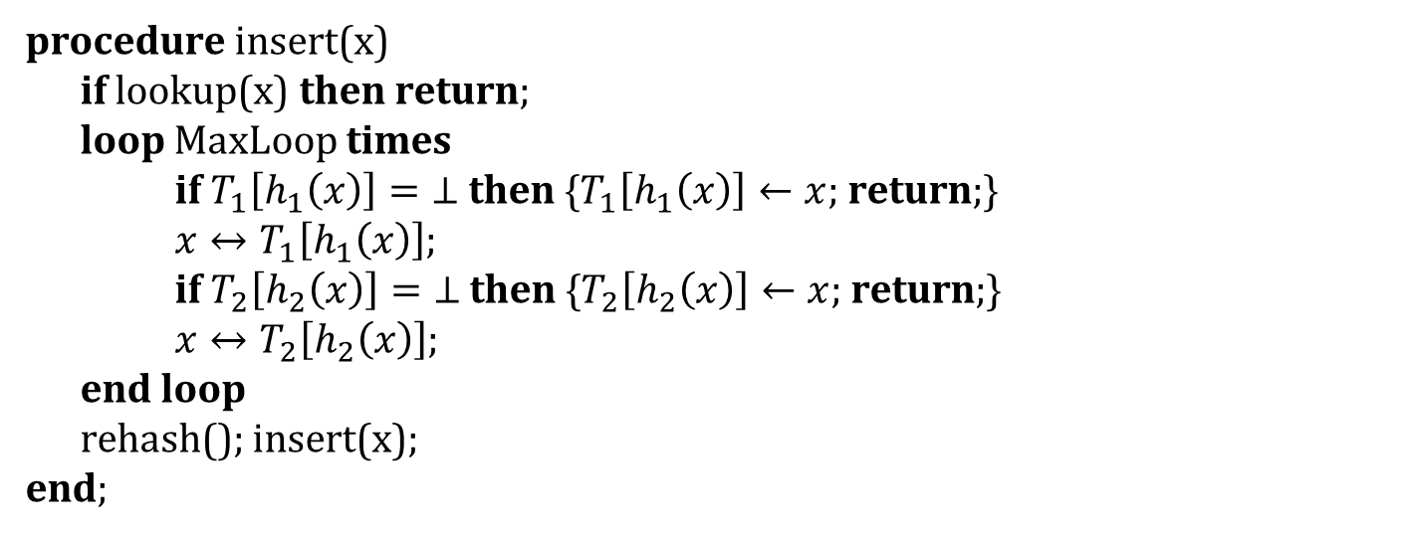
Cuckoo Hashing - Insert
Balanced Allocation
Data Binning
Cuckoo Hashing
procedure insert(x)
if lookup(x) then return;
loop MaxLoop times
if $T_{1}\left[h_{1}\left(x\right)\right]=\text{⊥}$ then {$T_{1}\left[h_{1}\left(x\right)\right]←x$; return;}
$x↔T_{1}\left[h_{1}\left(x\right)\right]$;
if $T_{2}\left[h_{2}\left(x\right)\right]=\text{⊥}$ then {$T_{2}\left[h_{2}\left(x\right)\right]←x$; return;}
$x↔T_{2}\left[h_{2}\left(x\right)\right]$;
end loop
rehash(); insert(x);
end;
*$x↔y$ expresses x and y are being swapped.

Slide 31
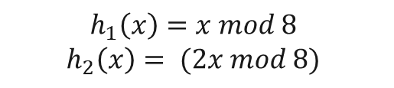






Cuckoo Hashing
Balanced Allocation
Data Binning
Cuckoo Hashing
Keys
Hash Functions
Hash Table 1
Hash Table 2
$$h_{1}\left(51\right)=3$$
51
$$h_{1}$$
0
0
1
1
$$h_{1}\left(133\right)=5$$
133
2
2
$$h_{1}\left(662\right)=6$$
662
3
3
$$h_{1}\left(534\right)=6$$
534
$$h_{2}$$
4
4
5
5
$$h_{1}\left(23\right)=7$$
23
6
6
$$h_{1}\left(445\right)=5$$
445
7
7
$$h_{1}\left(x\right)=x mod 8$$
$$h_{2}\left(x\right)= (2x mod 8)$$

Slide 32
Cuckoo Hashing
Balanced Allocation
Data Binning
Cuckoo Hashing
Keys
Hash Functions
Hash Table 1
Hash Table 2
Insert(534)
$$h_{1}\left(51\right)=3$$
51
$$h_{1}$$
0
0
1
1
$$h_{1}\left(133\right)=5$$
133
2
2
$$h_{1}\left(662\right)=6$$
662
51
3
3
$$h_{1}\left(534\right)=6$$
534
4
4
534
$$h_{2}$$
5
5
133
$$h_{1}\left(23\right)=7$$
23
6
6
662
$$h_{1}\left(445\right)=5$$
445
7
7
Collision
$$h_{1}\left(x\right)=x mod 8$$
$$h_{2}\left(x\right)= (2x mod 8)$$

Slide 33

Cuckoo Hashing
Balanced Allocation
Data Binning
Cuckoo Hashing
Keys
Hash Functions
Hash Table 1
Hash Table 2
Insert(534)
$$h_{1}\left(51\right)=3$$
51
$$h_{1}$$
0
0
1
1
$$h_{1}\left(133\right)=5$$
133
2
2
$$h_{1}\left(662\right)=6$$
662
51
3
3
$$h_{1}\left(534\right)=6$$
534
$$h_{2}$$
4
4
5
5
133
$$h_{1}\left(23\right)=7$$
23
6
6
534
$$h_{1}\left(445\right)=5$$
445
7
7
Collision
$$h_{2}\left(662\right)= \left(2x mod 8\right)=4$$
$$h_{1}\left(x\right)=x mod 8$$
$$h_{2}\left(x\right)= (2x mod 8)$$
662

Slide 34
Cuckoo Hashing
Balanced Allocation
Data Binning
Cuckoo Hashing
Keys
Hash Functions
Hash Table 1
Hash Table 2
Insert(534)
$$h_{1}\left(51\right)=3$$
51
$$h_{1}$$
0
0
1
1
$$h_{1}\left(133\right)=5$$
133
2
2
$$h_{1}\left(662\right)=6$$
662
51
3
3
4
4
$$h_{1}\left(534\right)=6$$
534
$$h_{2}$$
662
5
5
133
$$h_{1}\left(23\right)=7$$
23
6
6
534
$$h_{1}\left(445\right)=5$$
445
7
7
Collision
$$h_{2}\left(662\right)= \left(2x mod 8\right)=4$$
$$h_{1}\left(x\right)=x mod 8$$
$$h_{2}\left(x\right)= (2x mod 8)$$

Slide 35
Cuckoo Hashing
Balanced Allocation
Data Binning
Cuckoo Hashing
Keys
Hash Functions
Hash Table 1
Hash Table 2
Insert(23)
$$h_{1}\left(51\right)=3$$
51
$$h_{1}$$
0
0
1
1
$$h_{1}\left(133\right)=5$$
133
2
2
$$h_{1}\left(662\right)=6$$
662
51
3
3
4
4
$$h_{1}\left(534\right)=6$$
534
$$h_{2}$$
662
5
5
133
$$h_{1}\left(23\right)=7$$
23
6
6
534
$$h_{1}\left(445\right)=5$$
445
7
7
23
$$h_{1}\left(x\right)=x mod 8$$
$$h_{2}\left(x\right)= (2x mod 8)$$

Slide 36

Cuckoo Hashing
Balanced Allocation
Data Binning
Cuckoo Hashing
Keys
Hash Functions
Hash Table 1
Hash Table 2
Insert(445)
$$h_{1}\left(51\right)=3$$
51
$$h_{1}$$
0
0
1
1
$$h_{1}\left(133\right)=5$$
133
2
2
$$h_{1}\left(662\right)=6$$
662
51
3
3
4
662
$$h_{1}\left(534\right)=6$$
534
$$h_{2}$$
4
5
5
445
$$h_{1}\left(23\right)=7$$
23
6
6
534
$$h_{1}\left(445\right)=5$$
445
7
7
23
Collision
$$h_{2}\left(133\right)= \left(2x mod 8\right)=2$$
$$h_{1}\left(x\right)=x mod 8$$
$$h_{2}\left(x\right)= (2x mod 8)$$
133

Slide 37
Cuckoo Hashing
Balanced Allocation
Data Binning
Cuckoo Hashing
Keys
Hash Functions
Hash Table 1
Hash Table 2
Insert(445)
$$h_{1}\left(51\right)=3$$
51
$$h_{1}$$
0
0
1
1
$$h_{1}\left(133\right)=5$$
133
2
133
2
$$h_{1}\left(662\right)=6$$
662
51
3
3
4
662
$$h_{1}\left(534\right)=6$$
534
$$h_{2}$$
4
5
5
445
$$h_{1}\left(23\right)=7$$
23
6
6
534
$$h_{1}\left(445\right)=5$$
445
7
7
23
Collision
$$h_{2}\left(133\right)= \left(2x mod 8\right)=2$$
$$h_{1}\left(x\right)=x mod 8$$
$$h_{2}\left(x\right)= (2x mod 8)$$

Slide 38
Cuckoo Hashing
Balanced Allocation
Data Binning
Cuckoo Hashing
Keys
Hash Functions
Hash Table 1
Hash Table 2
$$h_{1}\left(51\right)=3$$
51
$$h_{1}$$
0
0
1
1
$$h_{1}\left(133\right)=5$$
133
2
133
2
$$h_{1}\left(662\right)=6$$
662
51
3
3
4
662
$$h_{1}\left(534\right)=6$$
534
$$h_{2}$$
4
5
5
445
$$h_{1}\left(23\right)=7$$
23
6
6
534
$$h_{1}\left(445\right)=5$$
445
7
7
23
$$h_{1}\left(x\right)=x mod 8$$
$$h_{2}\left(x\right)= (2x mod 8)$$

Slide 39

Cuckoo Hashing
Balanced Allocation
Data Binning
Cuckoo Hashing
Keys
Hash Functions
Hash Table 1
Hash Table 2
$$h_{1}\left(51\right)=3$$
51
$$h_{1}$$
0
0
1
1
$$h_{1}\left(133\right)=5$$
133
2
133
2
$$h_{1}\left(662\right)=6$$
662
51
3
3
4
662
$$h_{1}\left(534\right)=6$$
534
$$h_{2}$$
4
5
5
445
$$h_{1}\left(23\right)=7$$
23
6
6
534
534
$$h_{1}\left(445\right)=5$$
445
7
7
23
$$h_{1}\left(22\right)=6$$
22
22
$$h_{1}\left(x\right)=x mod 8$$
$$h_{2}\left(x\right)= (2x mod 8)$$

Slide 40

Cuckoo Hashing
Balanced Allocation
Data Binning
Cuckoo Hashing
Keys
Hash Functions
Hash Table 1
Hash Table 2
Insert(445)
$$h_{1}\left(51\right)=3$$
51
$$h_{1}$$
0
0
1
1
$$h_{1}\left(133\right)=5$$
133
2
133
2
$$h_{1}\left(662\right)=6$$
662
51
3
3
4
4
662
$$h_{1}\left(534\right)=6$$
534
$$h_{2}$$
662
5
5
445
$$h_{1}\left(23\right)=7$$
23
6
6
22
$$h_{1}\left(445\right)=5$$
445
7
7
23
$$h_{1}\left(22\right)=6$$
22
$$h_{2}\left(534\right)= \left(2x mod 8\right)=4$$
$$h_{1}\left(x\right)=x mod 8$$
$$h_{2}\left(x\right)= (2x mod 8)$$
Collision
534

Slide 41

Cuckoo Hashing
Balanced Allocation
Data Binning
Cuckoo Hashing
Keys
Hash Functions
Hash Table 1
Hash Table 2
Insert(445)
$$h_{1}\left(51\right)=3$$
51
$$h_{1}$$
0
0
1
1
$$h_{1}\left(133\right)=5$$
133
2
133
2
$$h_{1}\left(662\right)=6$$
662
51
3
3
4
534
4
$$h_{1}\left(534\right)=6$$
534
$$h_{2}$$
662
5
5
445
$$h_{1}\left(23\right)=7$$
23
6
6
22
$$h_{1}\left(445\right)=5$$
445
7
7
23
$$h_{1}\left(22\right)=6$$
22
$$h_{1}\left(662\right)= \left(x mod 8\right)=6$$
$$h_{1}\left(x\right)=x mod 8$$
$$h_{2}\left(x\right)= (2x mod 8)$$
Collision
662

Slide 42
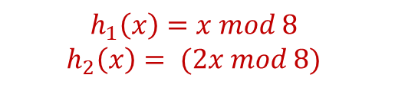

Cuckoo Hashing
Balanced Allocation
Data Binning
Cuckoo Hashing
Keys
Hash Functions
Hash Table 1
Hash Table 2
Insert(445)
$$h_{1}\left(51\right)=3$$
51
$$h_{1}$$
0
0
1
1
$$h_{1}\left(133\right)=5$$
133
2
133
2
$$h_{1}\left(662\right)=6$$
662
51
3
3
4
534
4
$$h_{1}\left(534\right)=6$$
534
$$h_{2}$$
662
5
5
445
$$h_{1}\left(23\right)=7$$
23
6
6
22
$$h_{1}\left(445\right)=5$$
445
7
7
23
$$h_{1}\left(22\right)=6$$
22
$$h_{1}\left(662\right)= \left(x mod 8\right)=6$$
$$h_{1}\left(x\right)=x mod 8$$
$$h_{2}\left(x\right)= (2x mod 8)$$
Collision
662

Slide 43
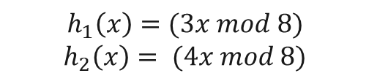

Cuckoo Hashing
Balanced Allocation
Data Binning
Cuckoo Hashing
Keys
Hash Functions
Hash Table 1
Hash Table 2
Insert(445)
$$h_{1}\left(51\right)=3$$
51
$$h_{1}$$
0
0
1
1
$$h_{1}\left(133\right)=5$$
133
2
133
2
$$h_{1}\left(662\right)=6$$
662
51
3
3
4
534
4
$$h_{1}\left(534\right)=6$$
534
$$h_{2}$$
662
5
5
445
$$h_{1}\left(23\right)=7$$
23
6
6
22
$$h_{1}\left(445\right)=5$$
445
7
7
23
$$h_{1}\left(22\right)=6$$
22
$$h_{1}\left(662\right)= \left(3x mod 8\right)=2$$
$$h_{1}\left(x\right)=(3x mod 8)$$
$$h_{2}\left(x\right)= (4x mod 8)$$
662

Slide 44
Cuckoo Hashing
Balanced Allocation
Data Binning
Cuckoo Hashing
Keys
Hash Functions
Hash Table 1
Hash Table 2
Insert(445)
$$h_{1}\left(51\right)=3$$
51
$$h_{1}$$
0
0
1
1
$$h_{1}\left(133\right)=5$$
133
2
133
662
2
$$h_{1}\left(662\right)=6$$
662
51
3
3
4
534
4
$$h_{1}\left(534\right)=6$$
534
$$h_{2}$$
662
5
5
445
$$h_{1}\left(23\right)=7$$
23
6
6
22
$$h_{1}\left(445\right)=5$$
445
7
7
23
$$h_{1}\left(22\right)=6$$
22
$$h_{1}\left(662\right)= \left(3x mod 8\right)=2$$
$$h_{1}\left(x\right)=(3x mod 8)$$
$$h_{2}\left(x\right)= (4x mod 8)$$

Slide 45
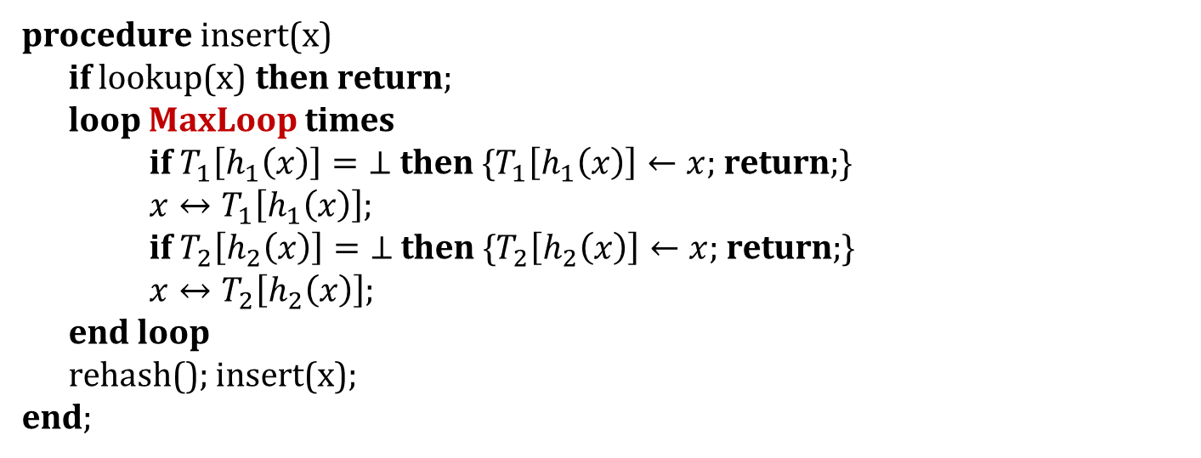
Cuckoo Hashing - Insert
Balanced Allocation
Data Binning
Cuckoo Hashing
procedure insert(x)
if lookup(x) then return;
loop MaxLoop times
if $T_{1}\left[h_{1}\left(x\right)\right]=\text{⊥}$ then {$T_{1}\left[h_{1}\left(x\right)\right]←x$; return;}
$x↔T_{1}\left[h_{1}\left(x\right)\right]$;
if $T_{2}\left[h_{2}\left(x\right)\right]=\text{⊥}$ then {$T_{2}\left[h_{2}\left(x\right)\right]←x$; return;}
$x↔T_{2}\left[h_{2}\left(x\right)\right]$;
end loop
rehash(); insert(x);
end;
How do we choose MaxLoop?
*$x↔y$ expresses x and y are being swapped.

Slide 46
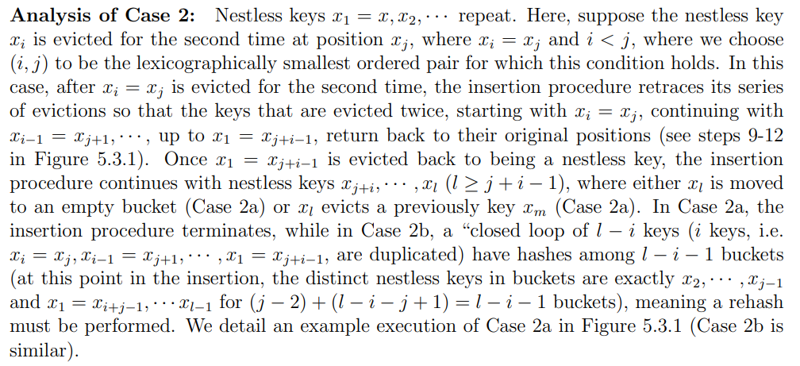
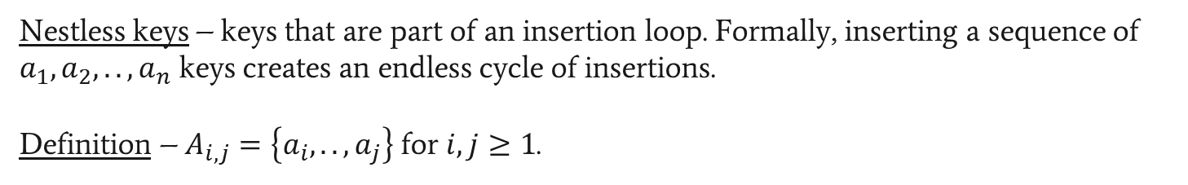
Cuckoo Hashing - Analysis
Balanced Allocation
Data Binning
Cuckoo Hashing
Nestless keys – keys that are part of an insertion loop. Formally, inserting a sequence of $a_{1},a_{2},..,a_{n}$ keys creates an endless cycle of insertions.
Definition – $A_{i,j}=\left\{a_{i},..,a_{j}\right\}$ for $i,j≥1$.

